Slide 1


Unit 2
HHFA indicator
inventory platform
Notes:
Welcome to Unit 2 of Module 3.

Slide 2
By the end of this unit, you will be able to:
explain what the HHFA indicator inventory platform is
access the indicator inventory platform online
Notes:
By the end of this unit, you will be able to:
explain what the HHFA indicator inventory platform is; and
access the indicator inventory platform online.

Slide 3
HHFA indicator inventory platform
1
2
3
4
5
6
7
Decide information needs
Adapt questionnaire & CSPro tool
Train data collectors
Collect data
Analyse data
Interpret, communicate & use data
Curate data
Indicator inventory platform
Notes:
The HHFA indicator inventory platform is a tool to support Step 1 of the 7 key HHFA steps.

Slide 4

HHFA indicators
Countries should review the HHFA indicators when making decisions about the information they want their HHFA to produce.
Notes:
After decisions on the survey objectives and related information needs, a review of the HHFA indicators should be the next step for countries when making decisions about the information they want their HHFA to produce.

Slide 5

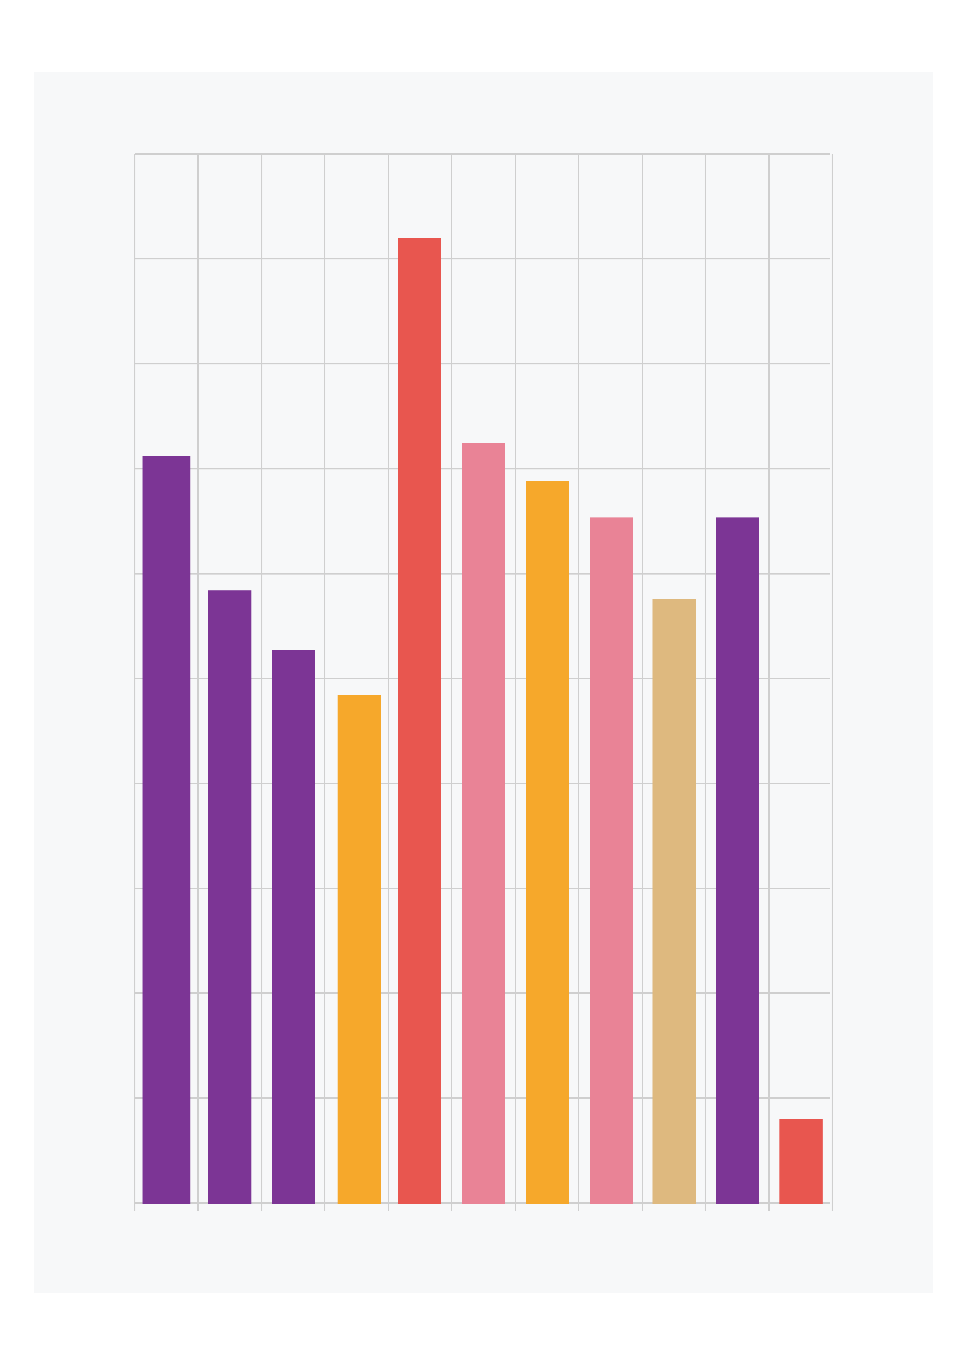
HHFA indicators
indicators show the information that the HHFA can provide
countries need to decide whether this information is what they need
Notes:
This is important because:
the indicators show the information that the HHFA can provide; and
countries need to decide whether this information is what they need.

Slide 6
HHFA indicators
Understanding the indicators informs:
the selection of the modules and questions for country implementation
any adaptations needed to the questionnaire
Notes:
Understanding the indicators therefore informs:
the selection of the modules and questions for country implementation; and
any adaptations needed to the questionnaire.

Slide 7
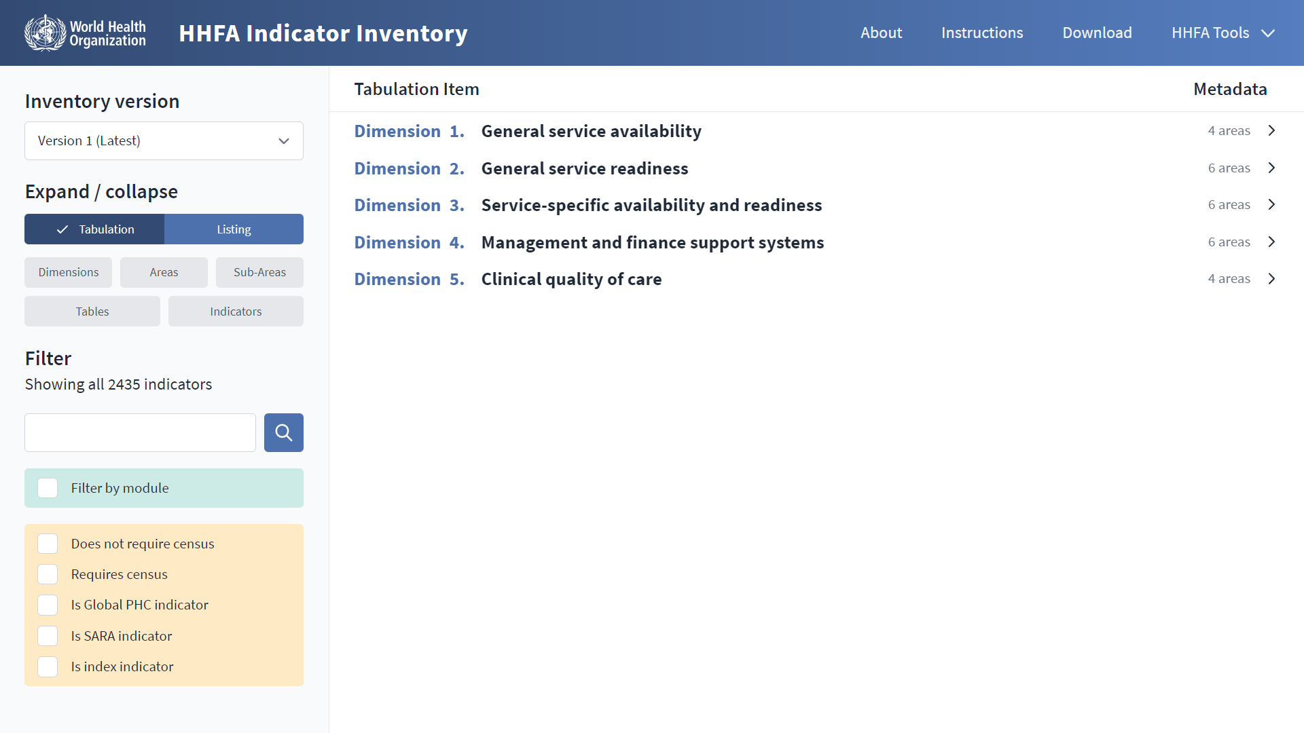
Key point
It is essential to review the indicator inventory at the start of the questionnaire adaptation process.
Notes:
It is essential to review the indicator inventory at the start of the questionnaire adaptation process.

Slide 8




HHFA indicators
HHFA questions
data
analysis
HHFA indicators
Notes:
The HHFA questions and questionnaires enable data to be collected. These data are then analysed to calculate the HHFA indicators.

Slide 9
HHFA indicators
Percentage facilities that:
Percentage facilities offering a specific service that:
offer a certain service
have a certain item available
have a certain item available
have a certain system/condition in place
have a certain system/condition
in place
Notes:
HHFA indicators are mostly percentages. The most common indicators are:
the percentage of facilities that offer a certain service, or that have a certain item available, or a certain system/condition in place; and
the percentage of facilities offering a specific service that have a certain item available, or a certain system/condition in place.

Slide 10
HHFA indicators: Examples
For example:
Availability
% facilities offering malaria services
Readiness: General
% facilities with electricity
Readiness:
Service - specific
% facilities offering malaria services with 1st line antimalarials in stock
Quality of Care
% ANC clients that received screening for syphilis during ANC
Management
and Finance
% facilities with a management committee that met in the last 3 months
Notes:
For example:
the percentage of facilities offering malaria services;
the percentage of facilities with electricity;
the percentage of facilities offering malaria services with first line antimalarials in stock;
the percentage of ANC clients that received screening for syphilis during ANC;
the percentage of facilities with a management committee that met within the past 3 months.

Slide 11
HHFA indices
%
%
index
%
Notes:
The HHFA also produces indices. An index is a value that summarizes information about a selected group of indicators.

Slide 12
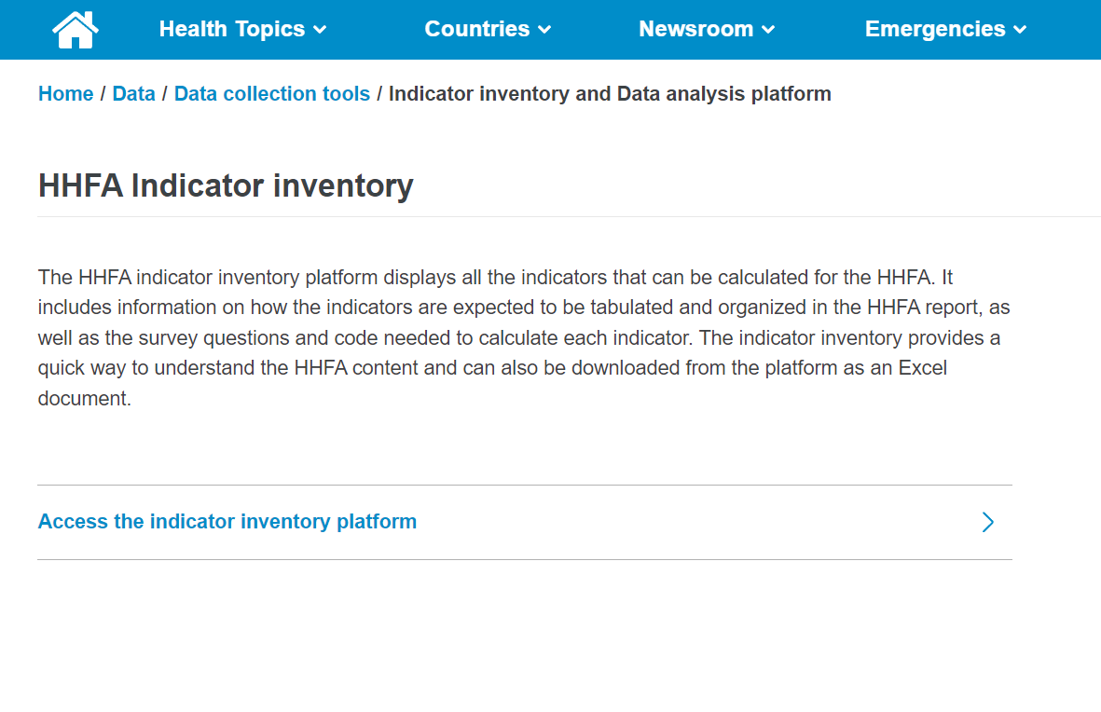
Accessing the HHFA indicator inventory platform
https://indicator-inventory.hhfa.online/
Notes:
All the current HHFA indicators are available in the HHFA online indicator inventory platform.
The indicator inventory platform can be accessed through indicator-inventory.hhfa.online, or by going to the WHO HHFA main webpage.

Slide 13
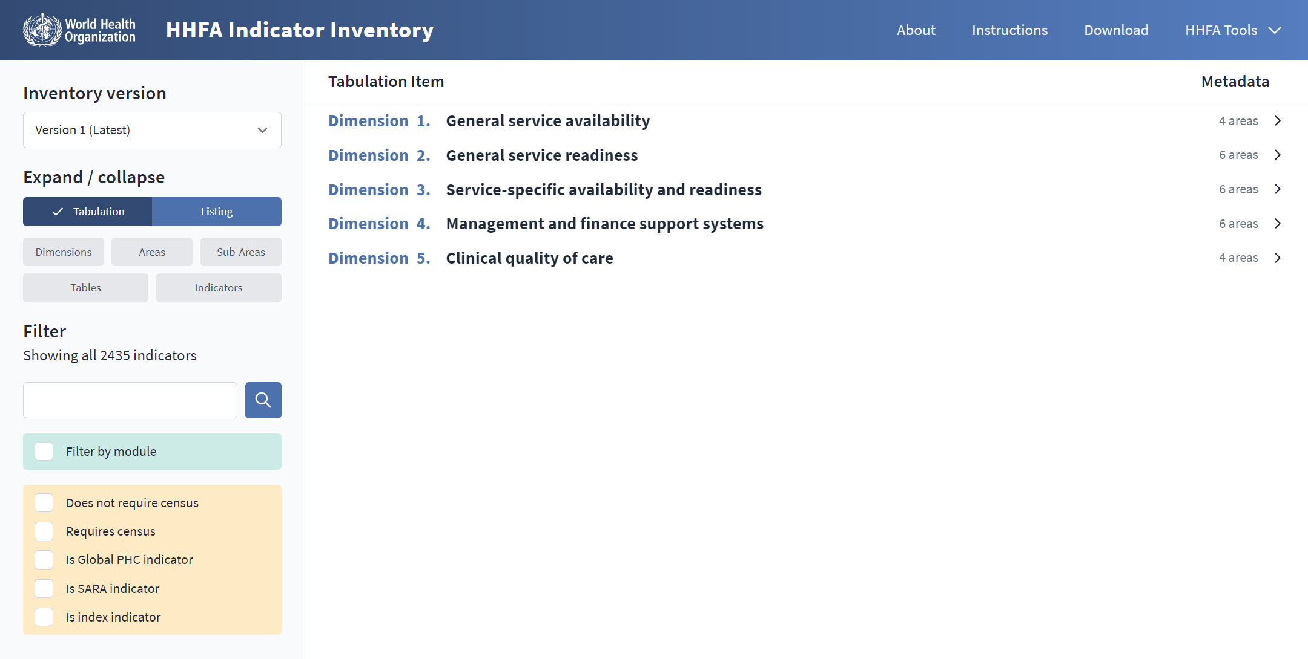
HHFA indicator inventory platform
Notes:
The indicator inventory platform provides a quick overview of the types of indicators the HHFA can produce and how they are organized.
The indicators are also organized in the same way in the output tables of the HHFA data analysis platform, so the inventory provides a good starting point for understanding the results of the HHFA.

Slide 14
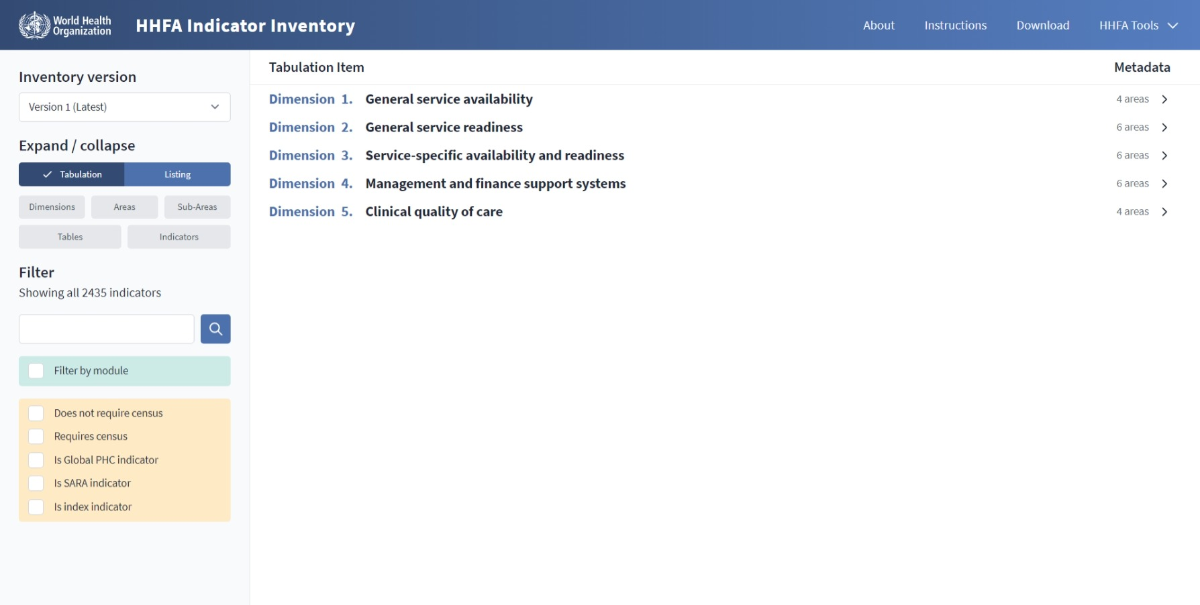
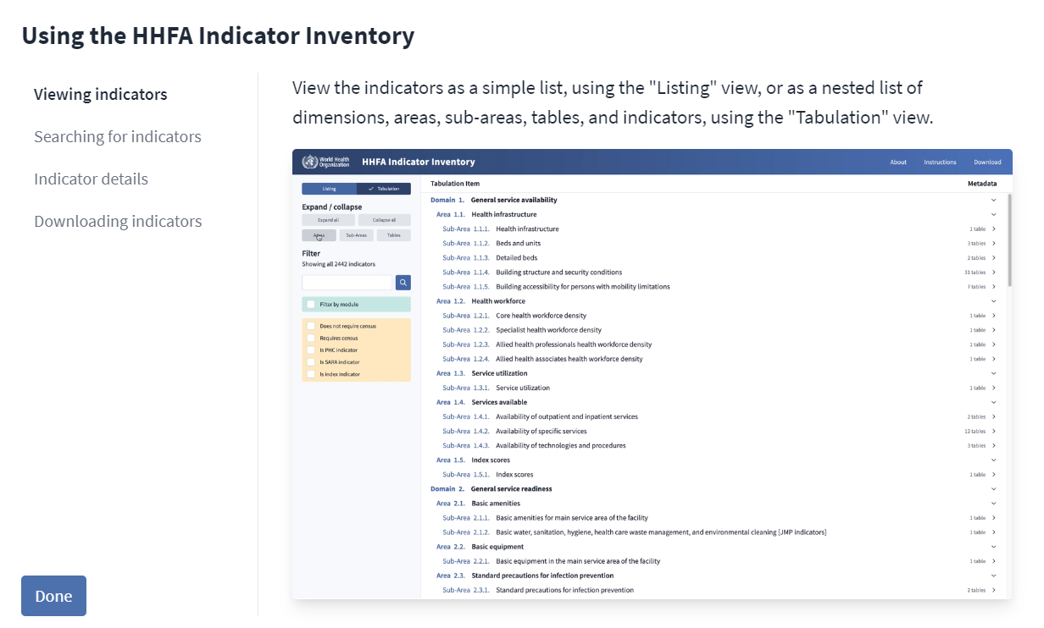
Instructions tab
Notes:
After accessing the platform, you can click the “Instructions” tab to access information to guide you through it.

Slide 15
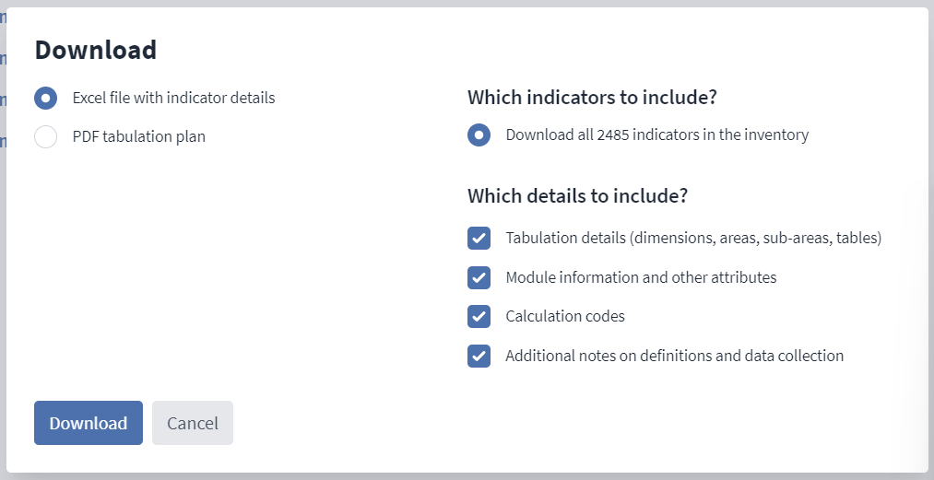
Download tab
Notes:
The indicators can also be downloaded as an Excel table by clicking the “Download” tab.

Slide 16
Service dimensions
Notes:
In the indicator inventory, the indicators are grouped into 5 main sections called “Service dimensions”. The 5 dimensions broadly correspond to the 4 HHFA modules.

Slide 17
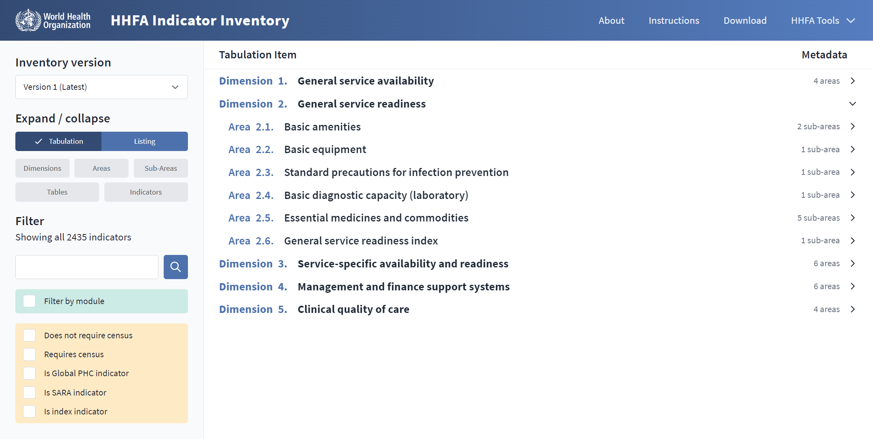
Service areas
Notes:
Within each dimension, indicators are organized hierarchically into:
service areas;

Slide 18
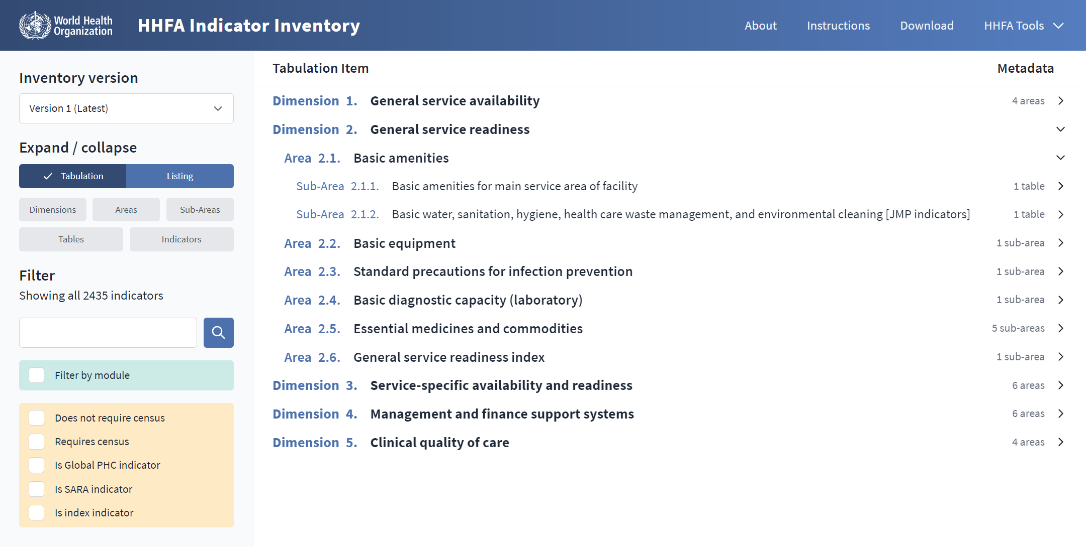
Service sub-areas
Notes:
service sub-areas; and

Slide 19
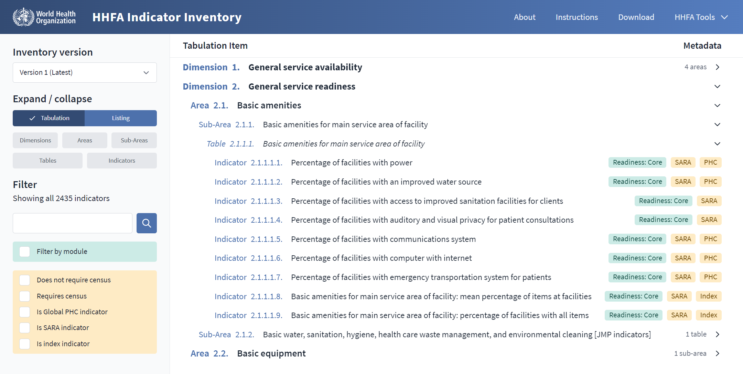
Tables and indicators
Notes:
tables, which contain the indicators.

Slide 20
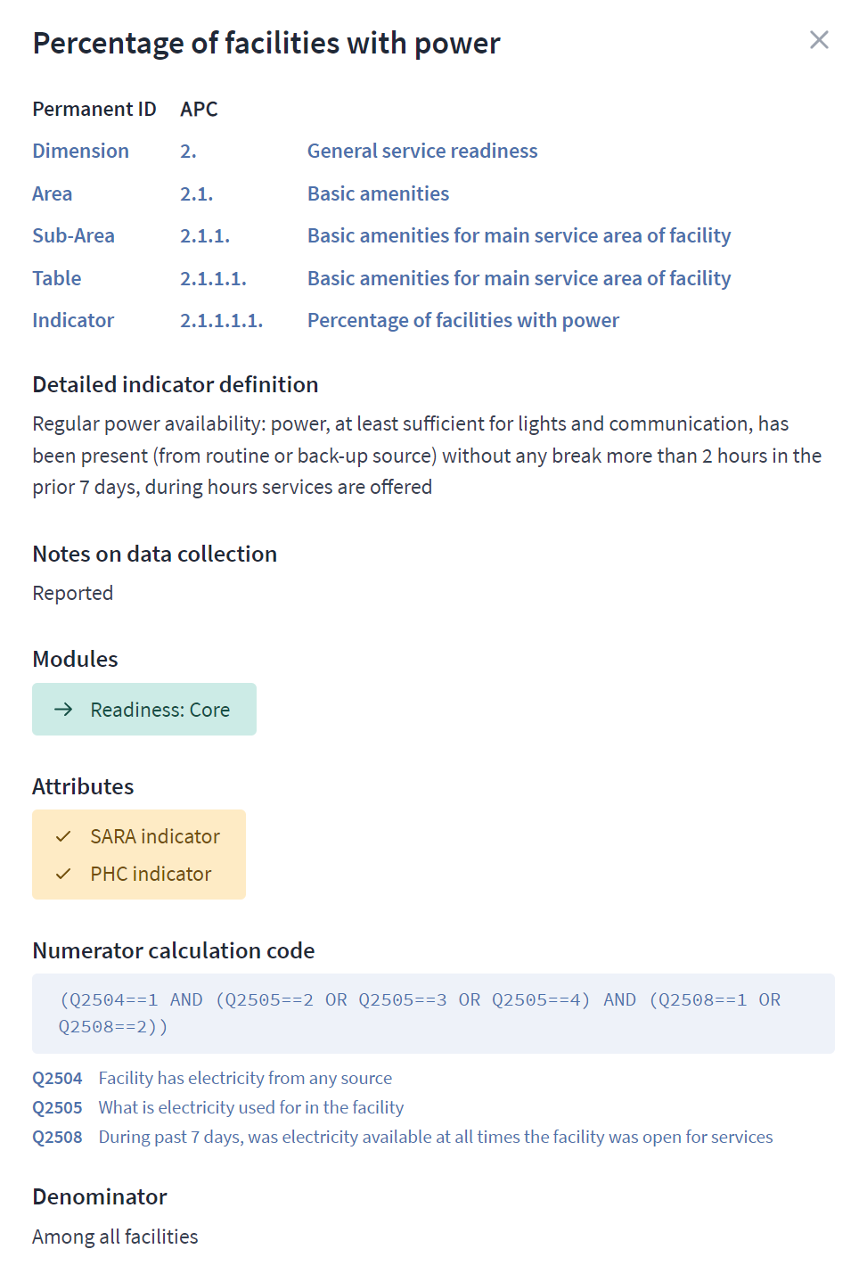
Detailed information for an indicator
Notes:
Detailed information is also available for each individual indicator, describing the indicator and the way it is calculated.

Slide 21
Search function
Notes:
And a Search function allows you to find a particular indicator or to filter for indicators related to a particular topic.

Slide 22
You have now completed Unit 2.
In the next unit, we will look at the different types of HHFA standard questionnaires.
Notes:
You have now completed Unit 2.
In the next unit, we will look at the different types of HHFA standard questionnaires.

